Slide 1
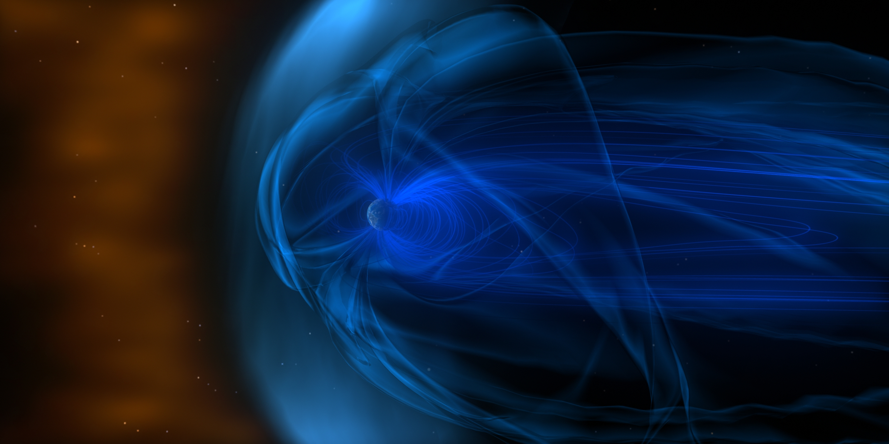
The Quasi Static Forced Breathing Squid
The Role of Solar Wind in Magnetospheric Oscillations
August 7, 2013
Yekaterina Gilbo, mentor: Dr. Kepko
SESI Final Presentation
Notes:
I studied the movement of the magnetosphere, specifically how and why it oscillates. I am going to explain how these oscillations are detected and their importance for our current theories on our magnetic environment.

Slide 2
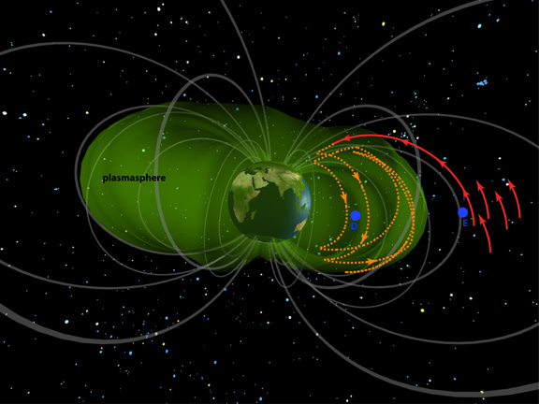
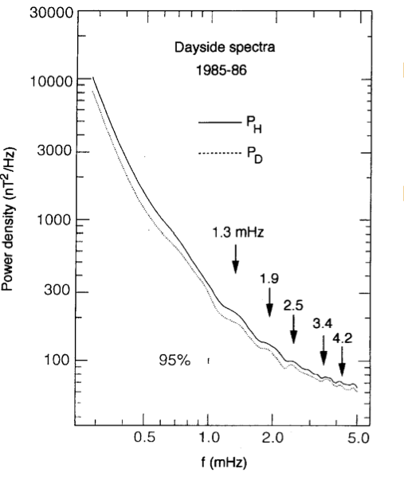
What is the source of magnetospheric oscillations?
solar plasma triggers ultra low frequency (ULF) waves
Magnetic field lines oscillate like standing waves;
V=Lf; v of ULF wave, L is length of field line
CMS ‘magic’ frequencies
Observed in high latitude radar and with ground magnetometers
Highly repeatable, discrete
=WAVE CAVITY MODE THEORY

Slide 3
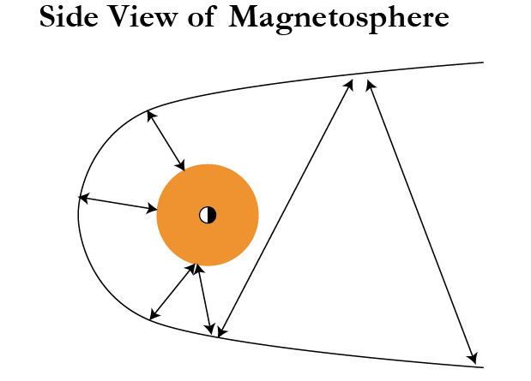
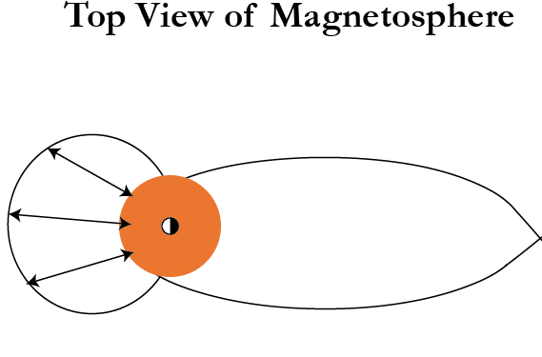
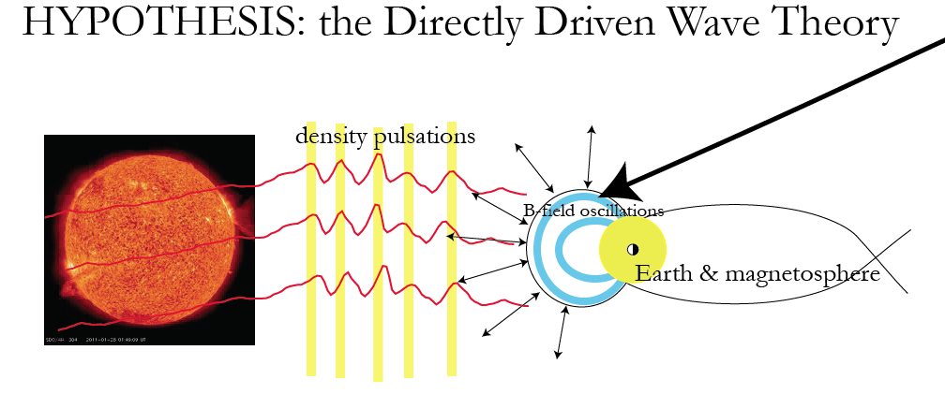
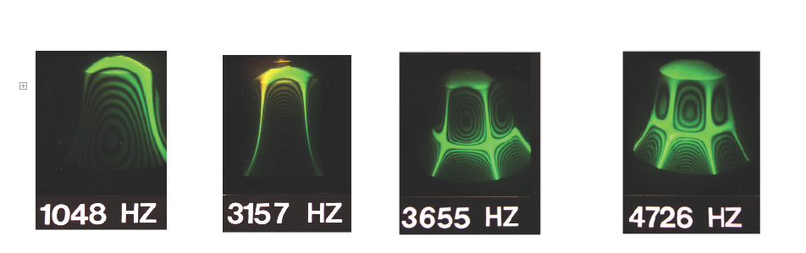
Wave Cavity Mode Model vs. Direct Driving Theory
(Solar wind) periodic density structures disturb magnetospheric equilibrium leading to oscillation of magnetic field lines.
Solar wind striking the magnetosphere leads to magnetospheric oscillations with magnetic field frequencies dependent on the magnetospheric cavity properties:
Alfven Wave speed
Reflection boundaries
General geometry
P_{d}=pv²=nmv²=P_{m}=pB²/(2μ₀)
ULF waves

Slide 4
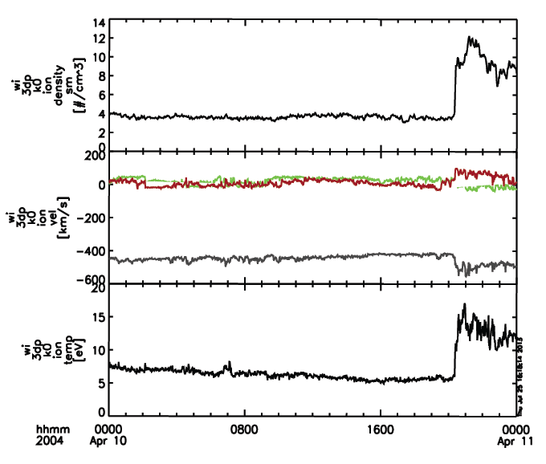
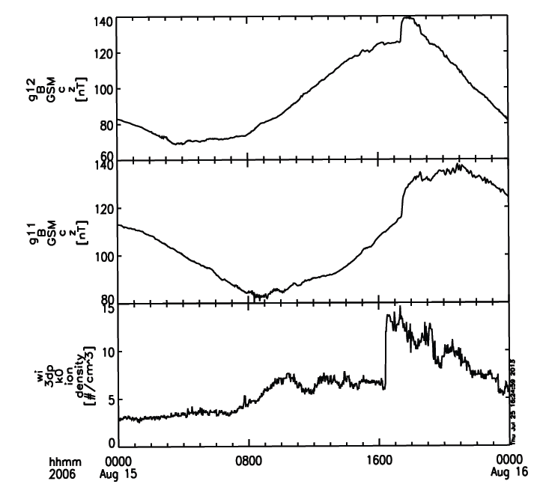
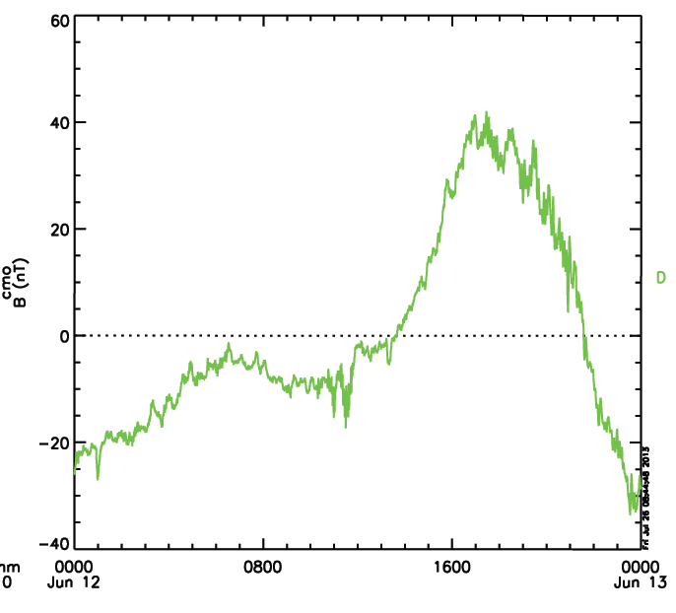
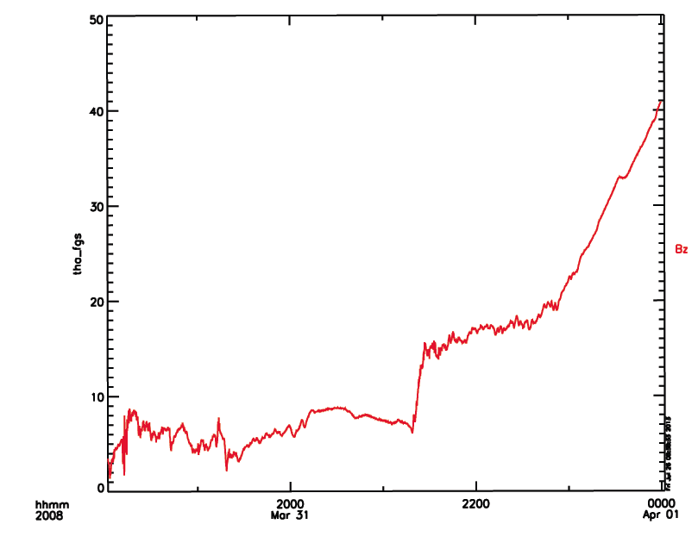
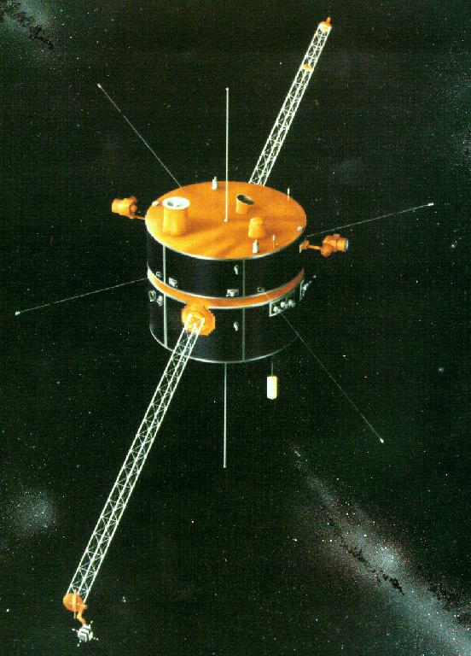
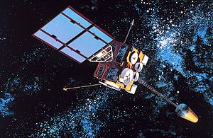
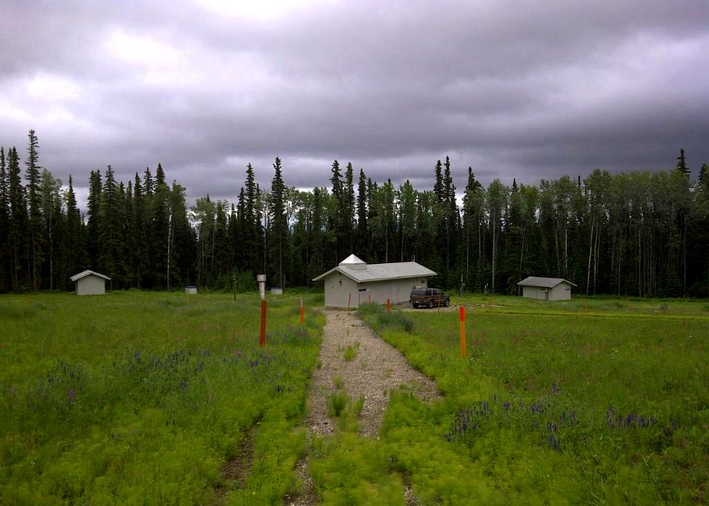
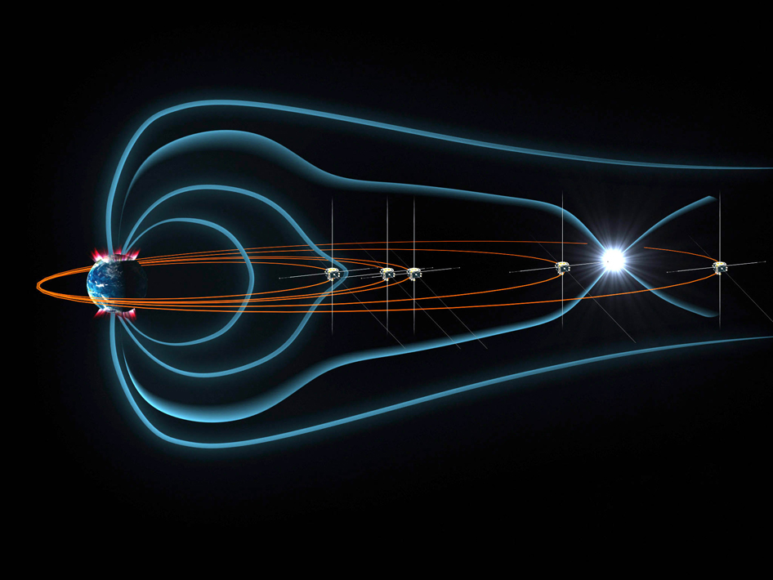
Exploring the theory: data collection and analysis.
Ground station:
CMO & GILL,
B field
THEMIS
A, B, C, D, E:
B field
Wind: density
GOES E & W:
B field
CMO; in Fairbanks, Alaska
~255 RE from Earth
6 RE from Earth
8-25 RE from Earth

Slide 5
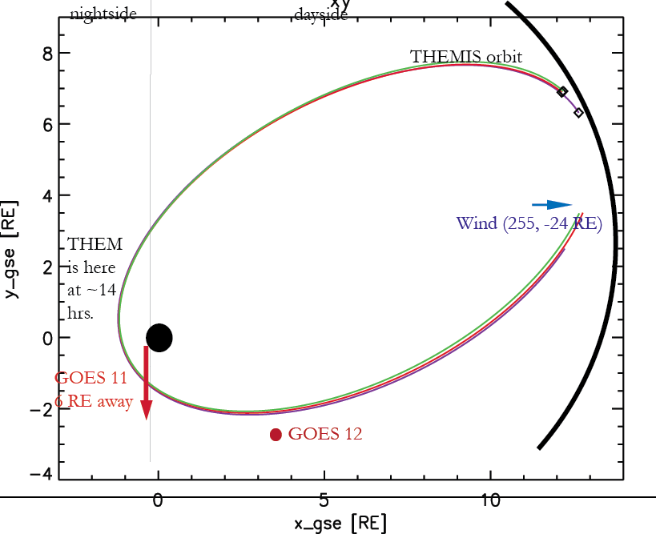
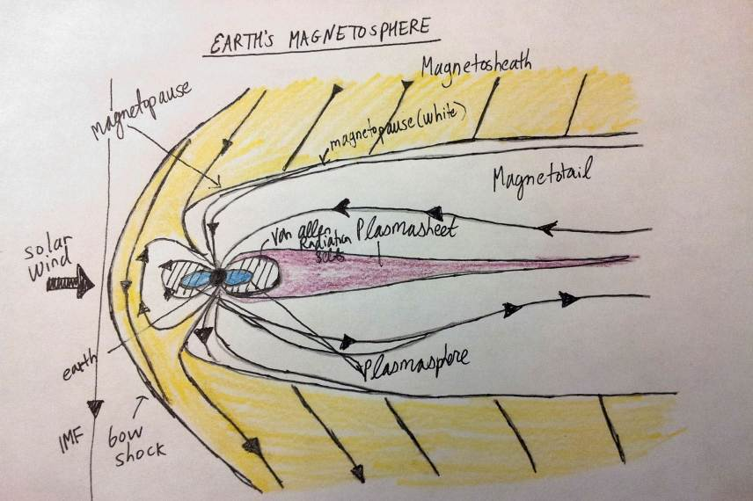
Exploring the theory: data collection and analysis.
Zooming in (time interval)
Smoothing
Detrending Transparency Function
Raw data of
shock events
Visually Processed
Data
Position can be found from velocity, energy flux, and magnetic fields.
Other criteria:
location (dayside; the region, which determines the signal)
orbital variations (filtering)
:

Slide 6
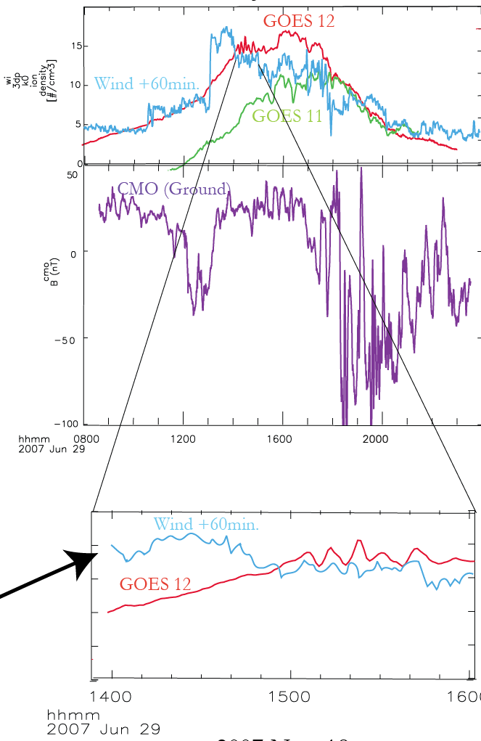
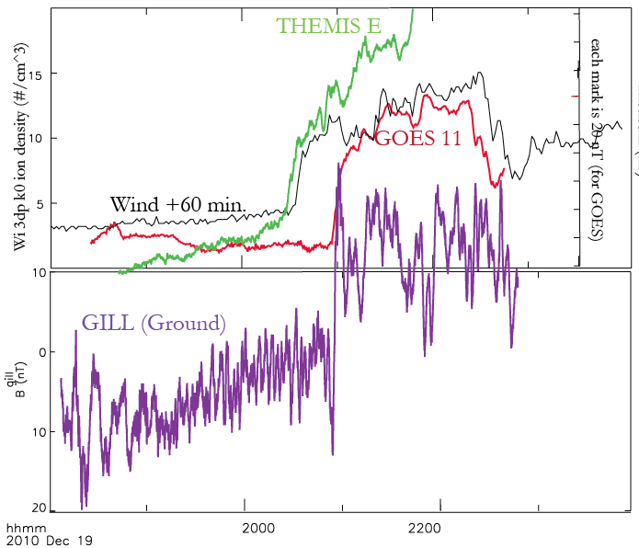
Results! (and this is just the beginning)
Jun. 29, 2007
Dec. 19, 2010

Slide 7
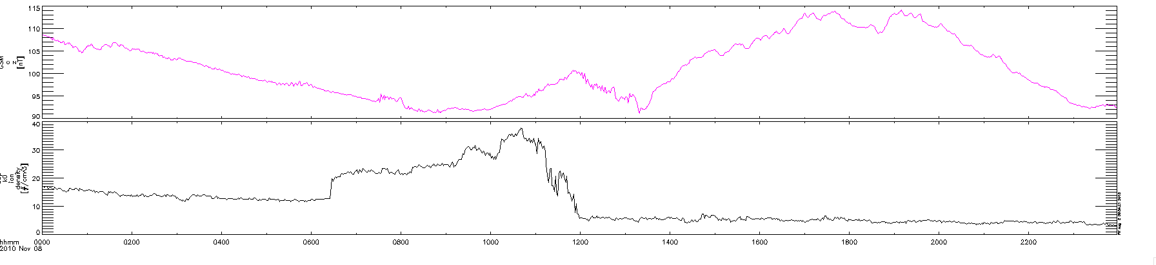
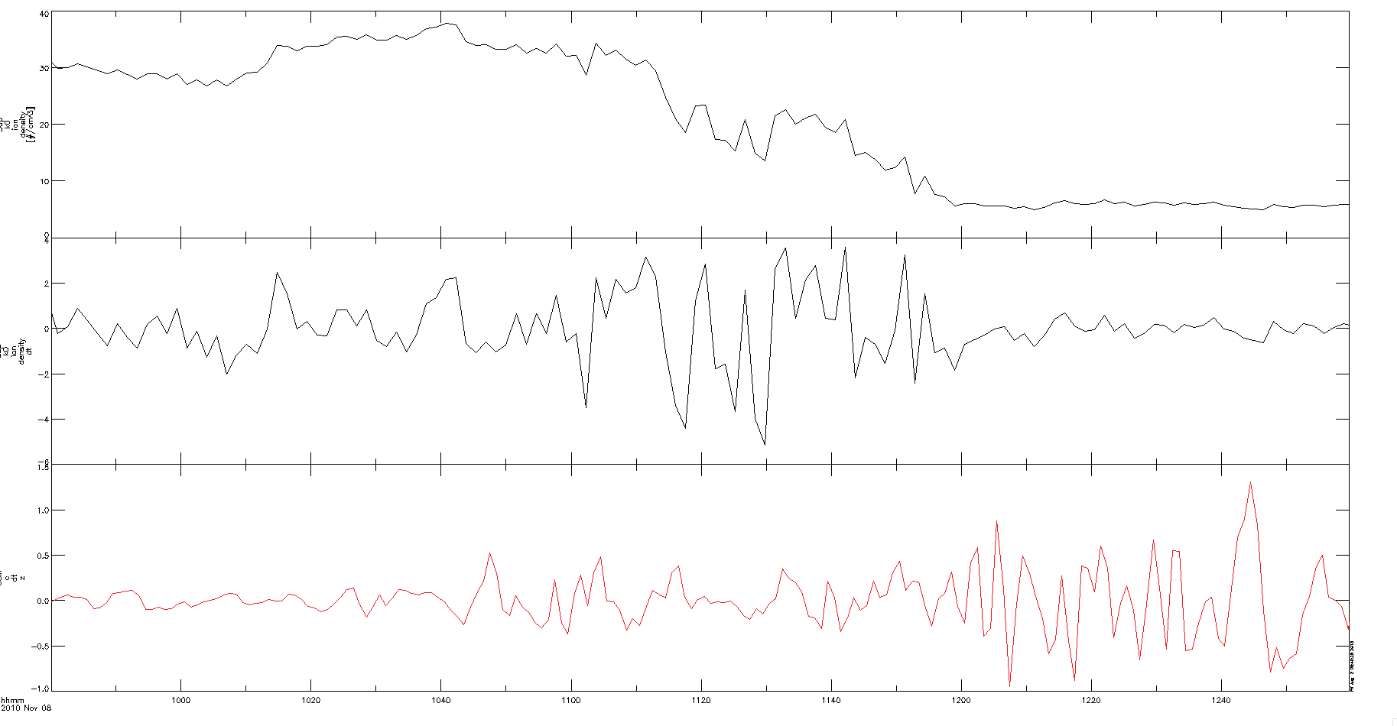
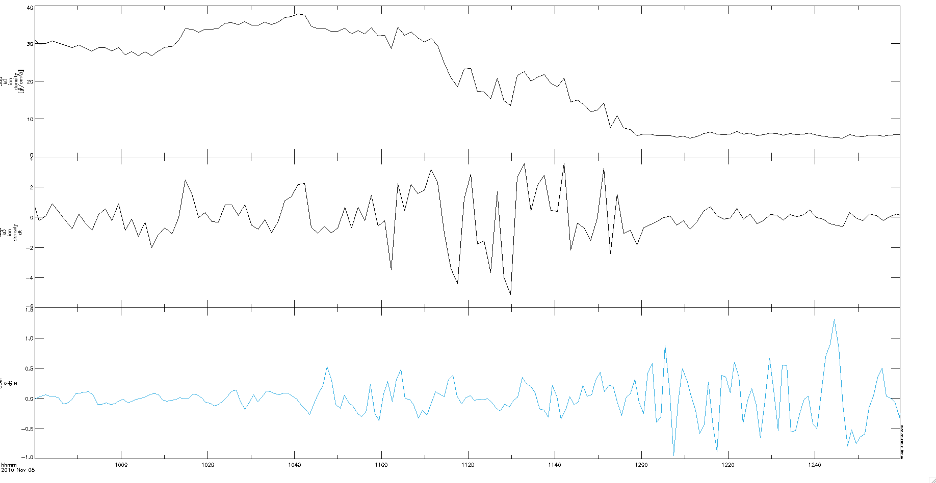
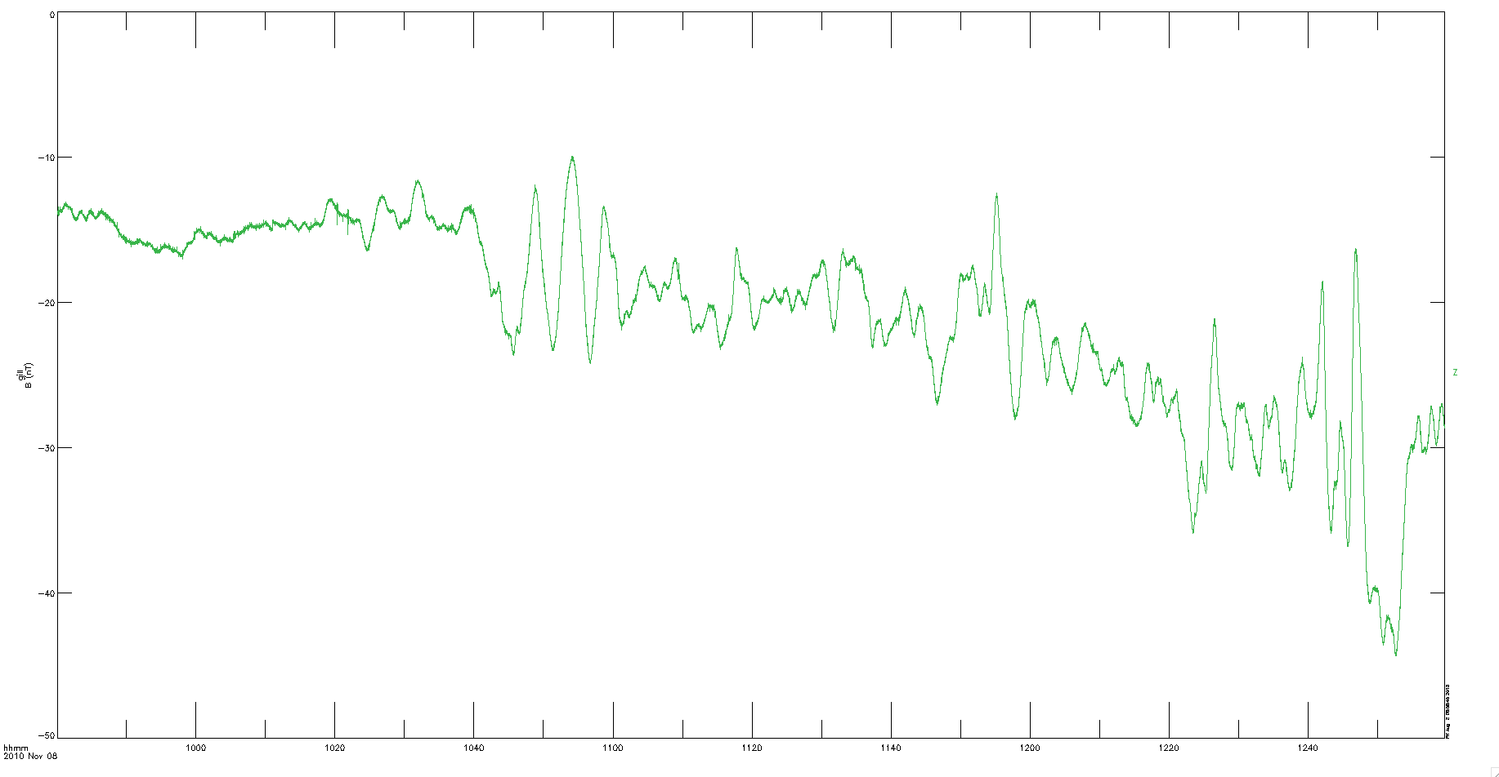
More Results: Individualized Analysis
2010 Nov 08
Raw data of event: 24 hour overview
GOES
Wind
Wind
Post detrending, shifting, and zooming in: 9:40 to 13:00
Wind
GOES dt
Gill (ground)
GOES dt (copy)

Slide 8
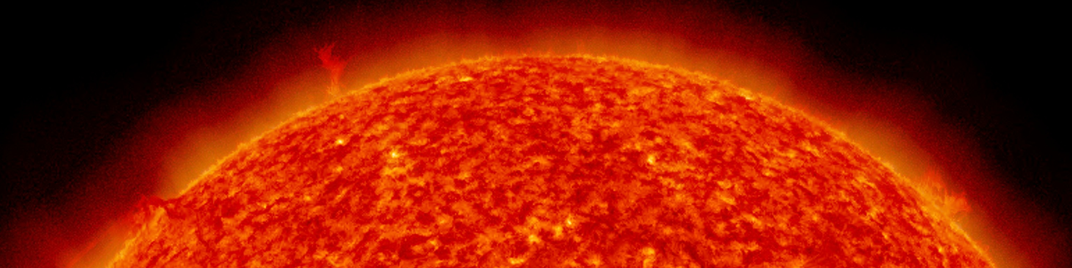
Conclusion
Out of 112 shock events analyzed (2004-2012), 35 promising events show visual correlation between shocks in Wind, GOES, THEMIS, and ground magnetometer data
With proper satellite conditions & individualized signal processing, 10-15 minute pulsations are found repeatedly
Correlated shocks last 2-4 hours, hard to see 15-30 min. pulsations (many challenges)
Oscillations present and preserved through their propagation from sun to earth, but challenging to detect
Comparison between cavity model and direct solar driving model, inconclusive until more events are analyzed
NE
NEXT STEPS

Slide 9
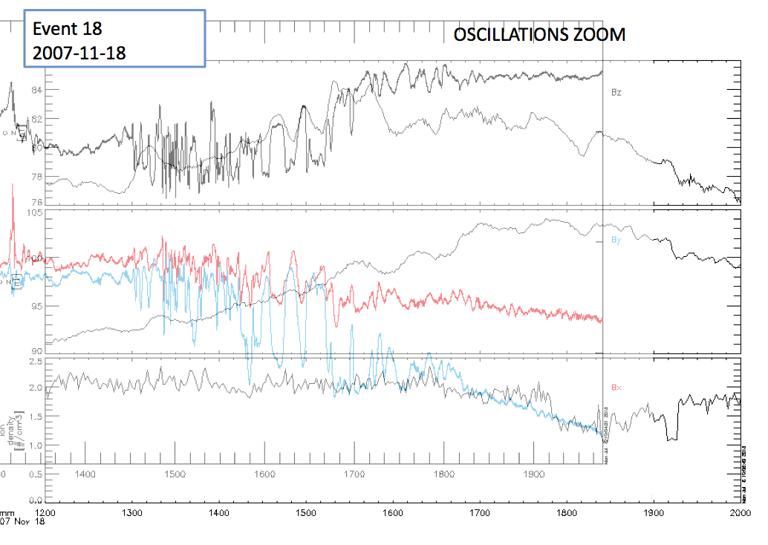
Onwards to the Future! More to do, more to do.
Further signal processing
-Fourier transforms to analyze power spectra, assess solar plasma turbulence, measure the frequencies of the ULF waves to quantify correlation between different magnetometer pulsations during one shock event
Analyze data as quasi-sinusoidal functions
Look at damping rate and what happens to frequencies with distance and time
solar wind oscillations may show the sun to be less turbulent than expected through these preserved density structures; important to continue to further study energy through wave propagation.
Many interesting (though somewhat irrelevant) patterns also to look at and investigate.
Notes:
Thank you for your attention. These 8 weeks have been electrifying with this cutting edge research experience, and I am so happy I have 2.5 weeks left to continue exploring space physics under the guidance of the best mentor ever, Dr. Kepko.

